Slide 1
A typical sysadmin day with Ralph
Daniel Pijanowski

Slide 2
Agenda
What is Ralph?
Daily tasks
Q&A

Slide 3
What is Ralph?
Ralph is full-featured Asset Management, DCIM and CMDB system for data center and back office.
Ralph
Core
Assets
Pricing “Scrooge”
Notes:
Ralph Core
Ralph Core (DCIM and CMDB) acts as a base system for Ralph applications. It is the database of Networks, IP Addresses, Racks, and discovered hardware.
It allows you to:scan networks automatically through periodic or manual scans.
deploy servers by generating appropriate DNS/DHCP configs and uses I/PXE method.
see relations between Configuration Items using CMDB view interface
Ralph Assets
This submodule provides advanced Asset management system which has following features:manual inventory system
can be used alongside Ralph Core discovery using reconciliation technique
covers complete life cycle of assets from purchase to decommissioning
gives ability to generate custom defined PDF documents (hardware assignments printouts for example)
integrated assets license management
integrated basic hardware support/contracts management
easy & usable module for generic inventory tasks
Ralph Pricing “Scrooge”
This submodule provides flexible billing and financial reporting subsystem which can:calculate TCO of Services using complex utilization of bare metal costs, IT Support work time, virtualization costs
integrate OpenStack billings with hardware costs
gather historical data every day to safely inspect trends over time

Slide 4
Daily tasks
Adding new devices to asset database,
Scanning and approving changes on host,
OS deployment,
DNS and DHCP records administration,

Slide 5
New hardware simplified installation workflow.
Adding new hardware to assets
Quick Scan
OS deployment
Additional tasks

Slide 6
Adding davice to assets
Minimum required details about device to add to assets are:
Define asset manufacturer,
Define asset model,
Define warehouse,
Serial number or barcode

Slide 7
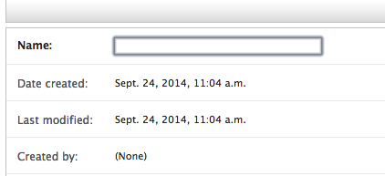
Asset – define manufacturer

Slide 8
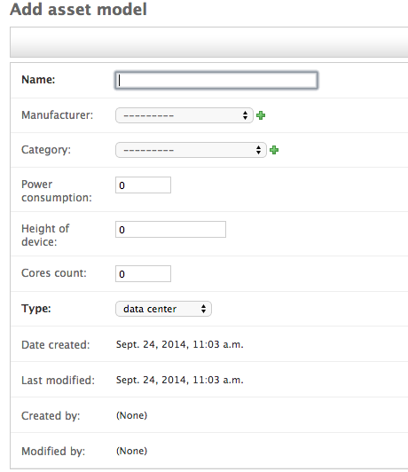
Asset – define model

Slide 9
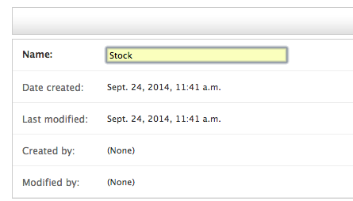
Asset – define warehouse

Slide 10
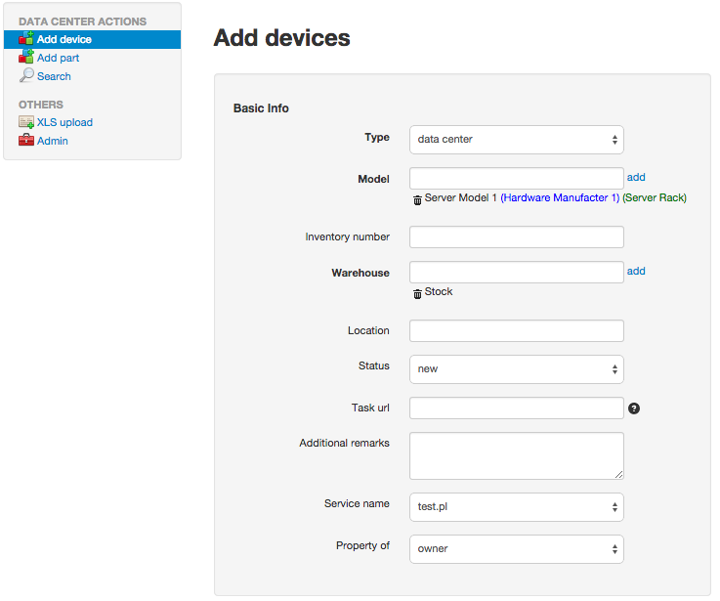
Asset – adding new device
Adding single devica via GUI
Bull add via XLS file

Slide 11
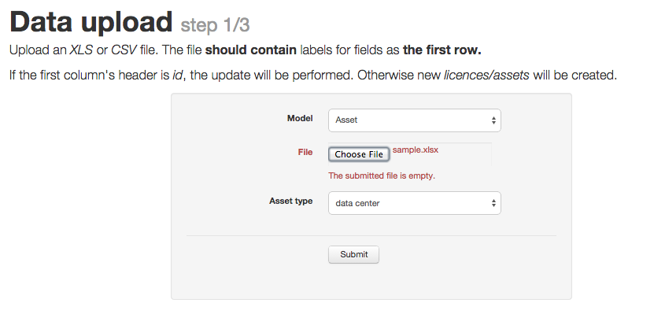
Asset – adding new device
Adding single devica via GUI
Bull add via XLS file

Slide 12
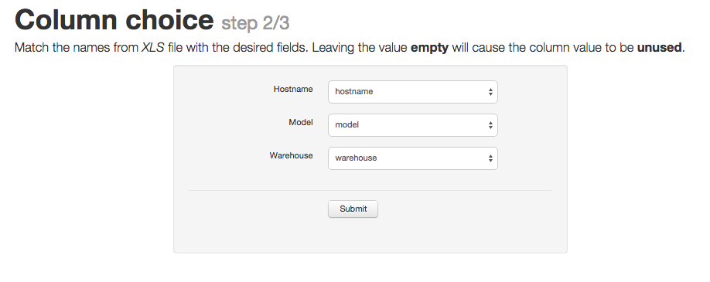
Asset – adding new device
Adding single devica via GUI
Bull add via XLS file

Slide 13
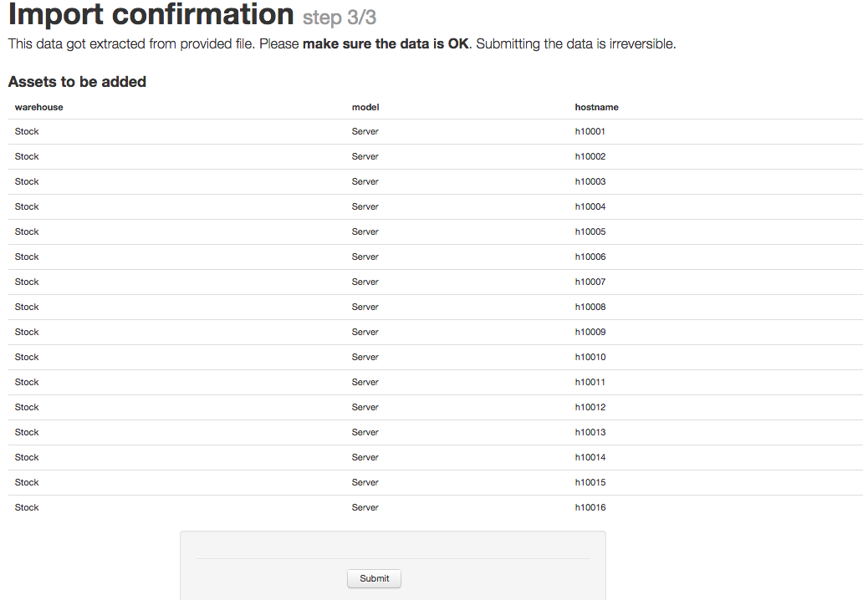
Asset – adding new device
Adding single devica via GUI
Bull add via XLS file

Slide 14
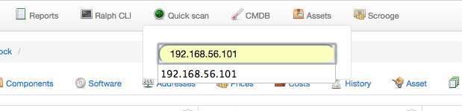
Quick Scan
“Quick scan” features which is the quickest way to scan given ip address.
Used to bond hardware with asset in Ralph.

Slide 15
OS deployment
Ralph has some mechanisms for automating deployment of servers.
The deployment process has to perform several tasks:
releasing any DNS names, DHCP entries
assigning an IP address, together with corresponding DNS and DHCP entries,
assigning the server to a new venture,
assigning a new role for the server in Puppet,
booting the server through PXE with a selected boot image and reinstalling its system.

Slide 16
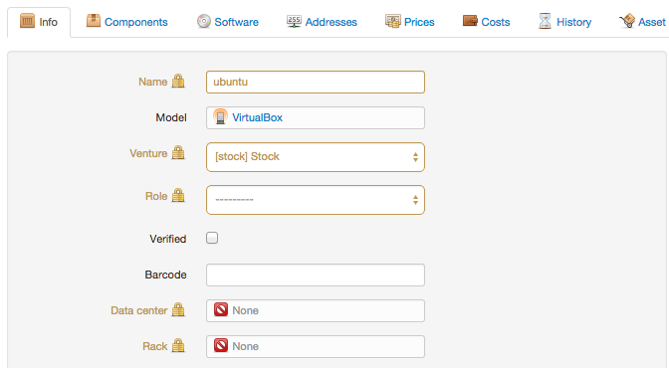
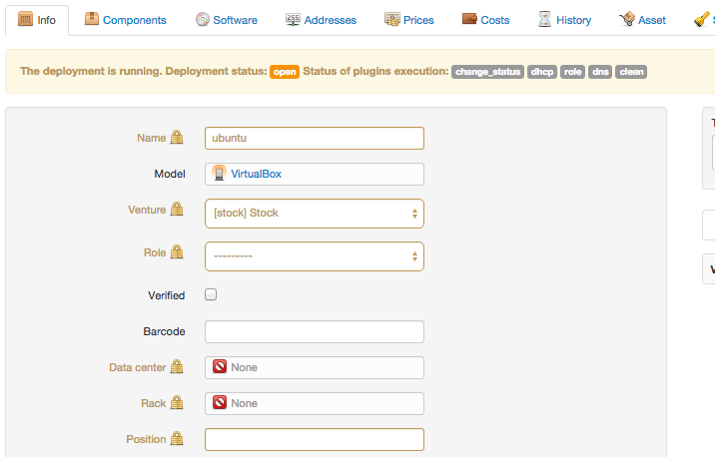
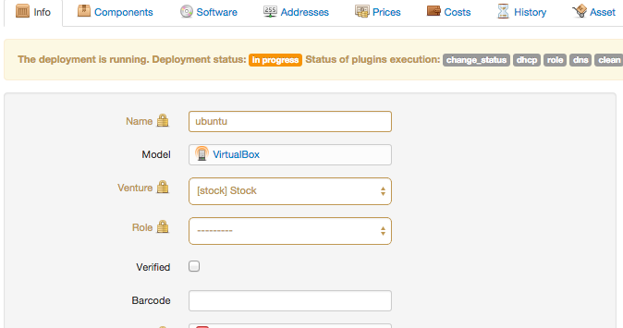
OS deployment
open
in progress
done
Notes:
A newly started deployment always starts as “open”. In that stage all the deployment plugins are executed, clearing old DNS and DHCP entries, creating new ones and assigning the server to a new Puppet role and venture. At that point the status is changed to “in progress” and the server has to be rebooted in order to install new operating system on it. As soon as the new system is installed and Puppet applies the server’s role, it sends a signal to Ralph that switches the status of the deployment to “done”. At this point the deployment is finished and it is archived.

Slide 17
Virtual Machine deployment
Using post request with JSON, YAML or XML data can be used for a quick deployment of VMs from templates.
Data sent via api should contain the following keys:
network: The name of the network for the new machine
management-ip: The IP of the container that will host the VM
mac: The MAC address of VMs network interface
venture: The symbol of the venture
venture-role: The name of the venture role

Slide 18
Virtual Machine deployment
Create virtual machine from template on hypervisor.
After successful creation of VM rescan hypervisor host.
Find VM and add DHCP and DNS records corresponding with it.

Slide 19
Device discovery
Pull
Push
periodically scan your all networks/environments and detect hardware information, software configuration and location
scan is using GUI, CLI or scheduled task
push data using your favorite tool/language through the API
view & accept your data using GUI

Slide 20
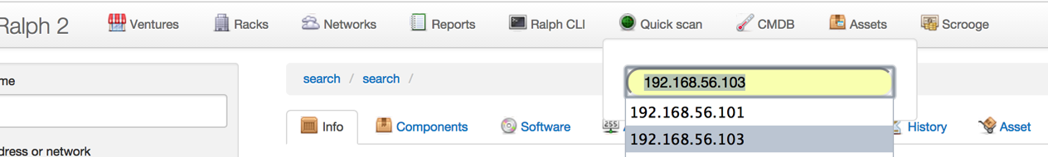
Device discovery - Pull

Slide 21
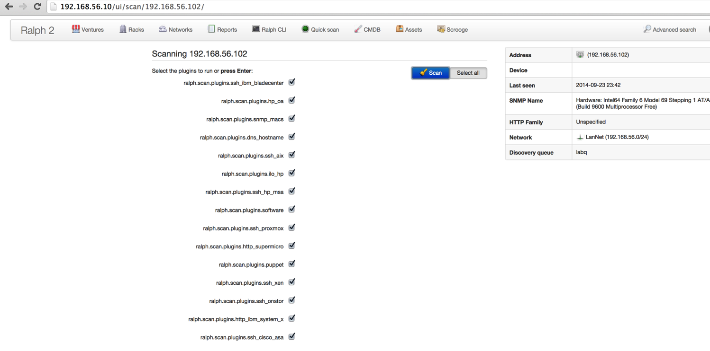
Device discovery - Pull

Slide 22
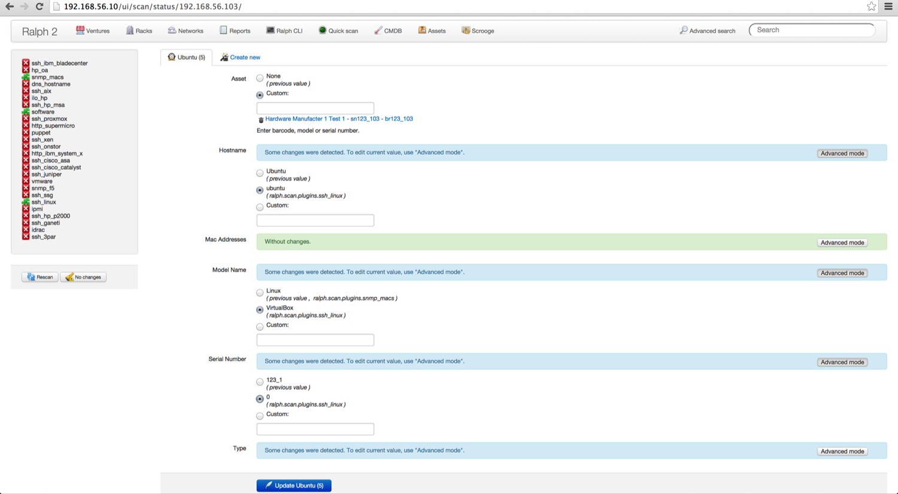
Device discovery - Pull

Slide 23
Device discovery - Push
Obtain an API Key from the Ralph interface - on the bottom part of the page you will see your login name (preference) click on it, and choose “Api key”. You will see your api key there.
Prepare your script which generates JSON data.
Send JSON data to the API interface using your script (REST call)
View & accept your data using GUI

Slide 24
Device discovery - Push
Sample date in JSON
{"data": {
"date": "2014-01-01 01:01:01",
"device": {"mac_addresses": ["de:ad:be:ef:ca:fe”] },
"plugin": "donpedro",
"status": "success"
}}
Pushing data in to Ralph using curl:
curl -XPOST http://ralph.lab.local/api/v0.9/scanresult/ -d @/tmp/data.json -H "Authorization: ApiKey user.name:api_key" -H "Content-type: application/json”
Apply change in GUI

Slide 25
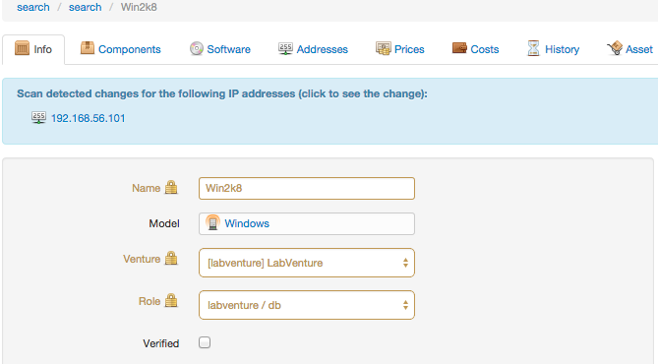
Device discovery - Push

Slide 26
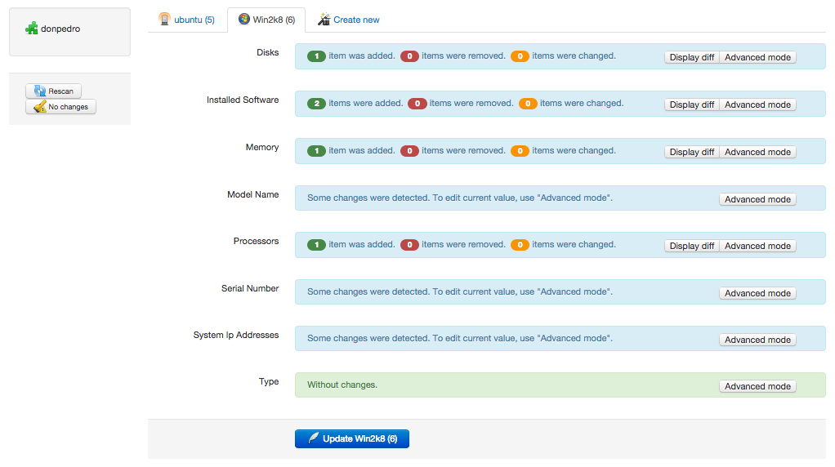
Device discovery - Push

Slide 27
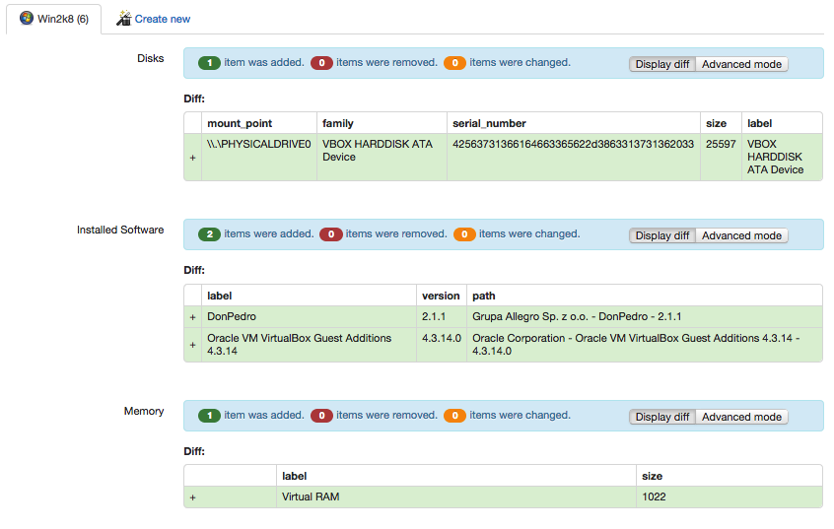
Device discovery - Push

Slide 28
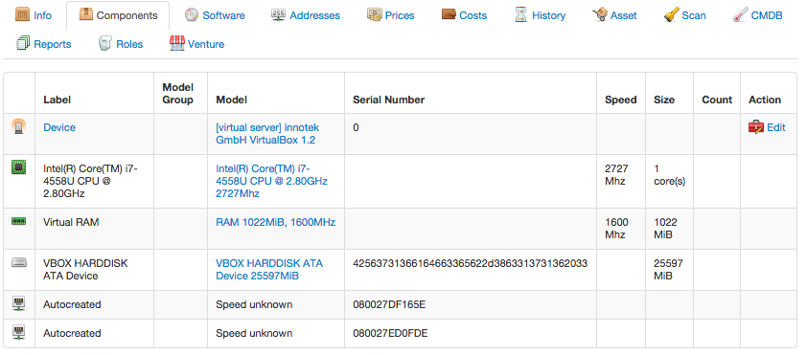
Device discovery - Push

Slide 29
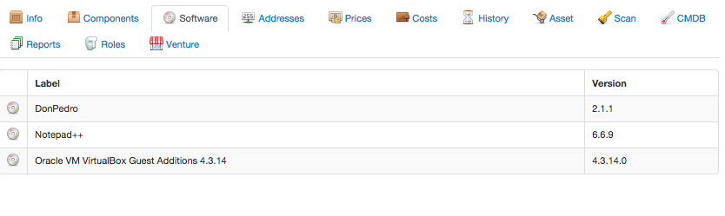
Device discovery - Push

Slide 30
Device discovery - Push
DonPedro is Ralph Windows Agent that provide hardware discovery.
Agent is using push method for sending scan data in JSON format to Ralph.
Running as a service in Microsoft Windows.
DonPedroOutput display all collected data from host and can save output in JSON format.

Slide 31
Beast
Beast is convenient Ralph API command line client.
It can be used as generic Tastypie command line client for querying, manipulating REST resources from the shell.

Slide 32
Beast - example
beast --help
Output:
Usage:
beast show
beast show <resource> [--debug] [--schema] [--fields=fields] [--filter=field_filter] [--csv] [--trim] [--width=max_width] [--silent] [--limit=limit]
beast update <resource> <id> <fields> <fields_values>
beast create <resource> [--data=json_data] [--file=path_to_the_json_file]
beast -h | --help
beast --version

Slide 33
Beast - example
beast show venture --limit=1
Output:
Limited rows requested: 1
----------------------------------------------------------------
| name | cache_version| created | symbol | modified |
----------------------------------------------------------------
| Venture1 | 2 | 2012-06-13| venture1 | 2012-06-14|
----------------------------------------------------------------

Slide 34
DNS and DHCP records administration
DNS
DHCP
Ralph stores and manipulates the information about domain names in its database is compatible with the way the PowerDNS
Ralph generate configuration for your DHCP servers

Slide 35
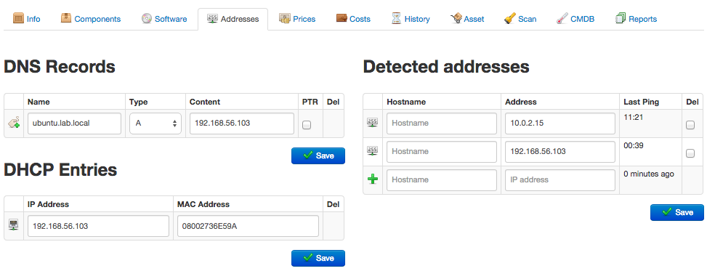
DNS and DHCP records administration

Slide 36
Device browser
Ralph web interface allows you to browser your discovered devices in five ways:
racks – view physical organisation of your datacenter.
ventures - organisations and by the services to which they belong.
networks - datacenter from the point of view of the network.
CMDB - displays the devices relevant to change management, together with their relations and changes.
advanced search – create custom lists of devices based on many attributes set on them, such as name, model etc.

Slide 37
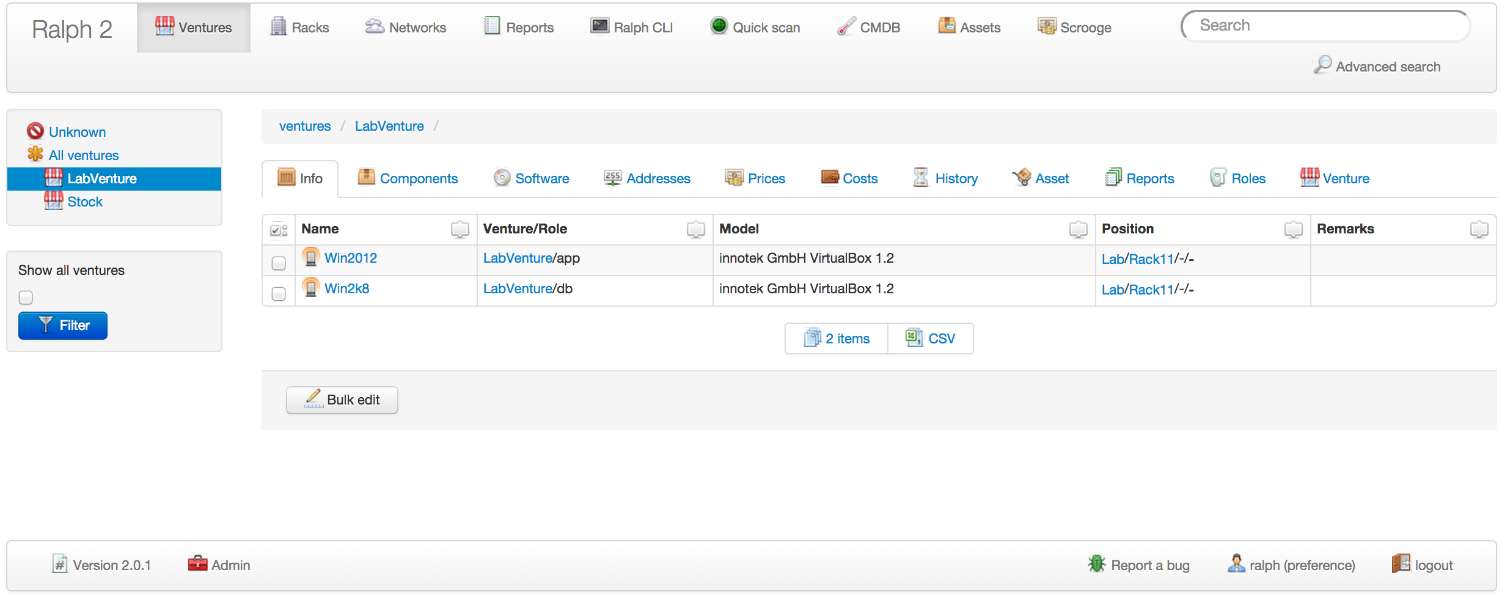
Device browser - Ventures

Slide 38
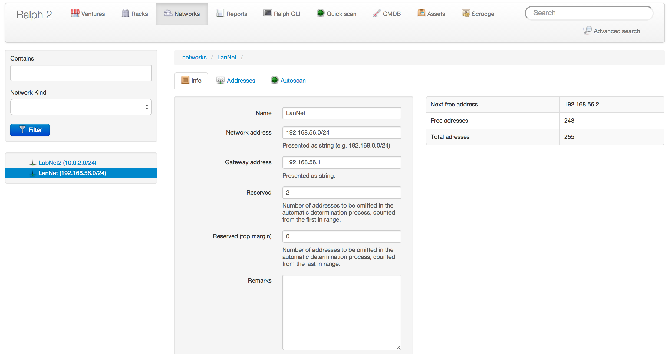
Device browser - Networks

Slide 39
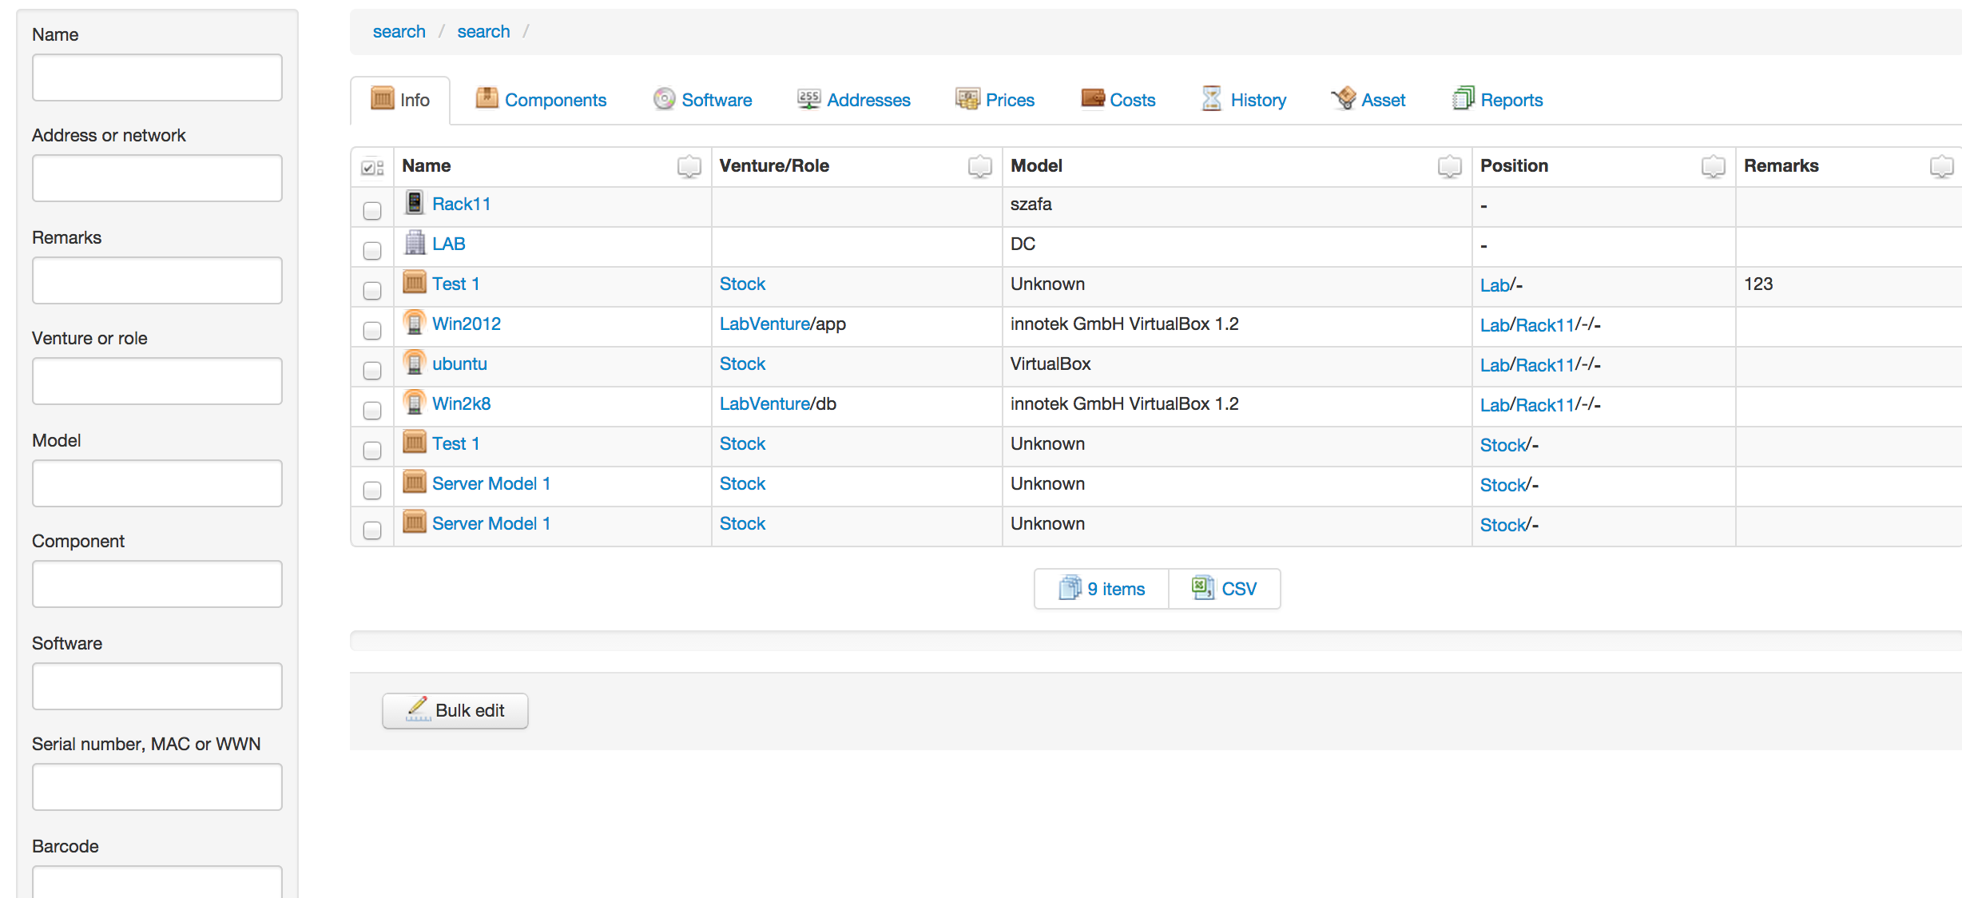
Device browser - Advanced Search

Slide 40
Sources
https://github.com/allegro/ralph
https://github.com/allegro/ralph_beast
http://allegrotech.io/

Slide 41
Q&A

Slide 42
